Slide 1

Linked Lists
list elements are stored, in memory, in an arbitrary order
explicit information (called a link) is used to go from one element to the next

Slide 2
Memory Layout
Layout of L = (a,b,c,d,e) using an array representation.
a
b
c
d
e
A linked representation uses an arbitrary layout.
c
a
e
d
b
Notes:
The figures show computer memory. An array uses a contiguous chunk of memory.

Slide 3

Linked Representation
c
a
e
d
b
first
pointer (or link) in e is NULL
use a variable first to get to the first element a

Slide 4
Normal Way To Draw A Linked List
first
NULL
a
b
c
d
e
link or pointer field of node
data field of node

Slide 5
Chain
first
NULL
a
b
c
d
e
A chain is a linked list in which each node represents one element.
There is a link or pointer from one element to the next.
The last node has a NULL (or 0) pointer.

Slide 6
Node Representation
typedef struct listNode *listPointer;
typedef struct {
char data;
listPointer link;
} listNode;
link
data

Slide 7
get(0)
first
NULL
a
b
c
d
e
desiredNode = first; // gets you to first node
return desiredNode−>data;
Notes:
Move to desired node. Note that desired node may not exist. Once you are at the desired node, you can return the element in that node as in
return desiredNode.element;
When firstNode = null, there is no element whose index is 0.

Slide 8
get(1)
first
NULL
a
b
c
d
e
desiredNode = first−>link; // gets you to second node
return desiredNode−>data;
Notes:
Node that desiredNode may not exist!

Slide 9
get(2)
first
NULL
a
b
c
d
e
desiredNode = first−>link−>link; // gets you to third node
return desiredNode−>data;
Notes:
Note that desiredNode may not exist

Slide 10
get(5)
first
NULL
a
b
c
d
e
desiredNode = first−>link−>link−>link−>link−>link;
// desiredNode = NULL
return desiredNode−>data; // NULL.element
Notes:
Get an exception now as NULL->data is illegal!

Slide 11
Delete An Element
first
NULL
a
b
c
d
e
delete(0)
deleteNode = first;
first = first−>link;
free(deleteNode);
Notes:
Note that node 0 may not exist!

Slide 12
delete(2)
first
NULL
c
a
b
c
b
c
d
e
beforeNode
first get to node just before node to be removed
beforeNode = first−>link;

Slide 13
delete(2)
first
null
a
b
c
d
e
beforeNode
save pointer to node that will be deleted
deleteNode = beforeNode−>link;

Slide 14
delete(2)
first
null
a
b
c
d
e
beforeNode
now change pointer in beforeNode
beforeNode−>link = beforeNode−>link−>link;
free(deleteNode);

Slide 15
insert(0,’f’)
first
NULL
f
a
b
c
d
e
newNode
Step 1: get a node, set its data and link fields
MALLOC( newNode, sizeof(*newNode));
newNode->data = ‘f’;
newNode->link = NULL;
Notes:
First, do a checkIndex.

Slide 16
insert(0,’f’)
first
NULL
f
a
b
c
d
e
newNode
Step 2: update first
first = newNode;

Slide 17
insert(3,’f’)
first
newNode
f
NULL
a
b
c
c
d
e
beforeNode
first find node whose index is 2
next create a new node and set its data and link fields
finally link beforeNode to newNode

Slide 18
insert(3,’f’)
first
newNode
f
NULL
a
b
c
c
d
e
beforeNode
beforeNode = first−>link−>link;
MALLOC( newNode, sizeof(*newNode));
newNode->data = ‘f’;
newNode->link = beforeNode->link;
beforeNode−>link = newNode;

Slide 19

Chain With Header Node
headerNode
NULL
a
b
c
d
e
Notes:
Now insert/erase at left end (I.e., index = 0) are no different from any other insert/delete. So insert/delete code is simplified.

Slide 20
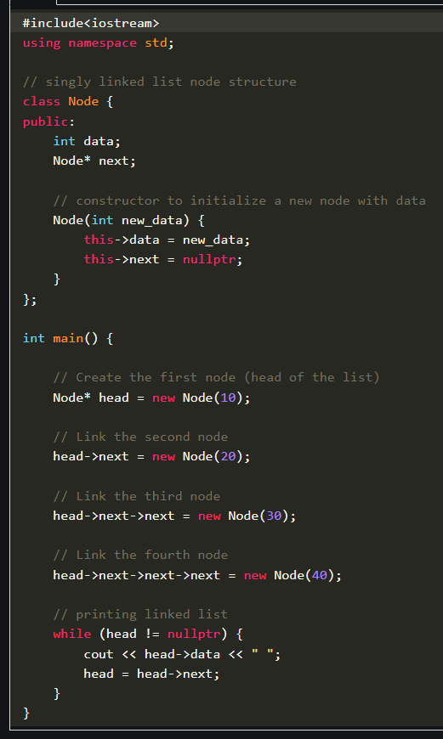

Output: 10 20 30 40

Slide 21
An integer linked list
First Node of List
Last Node of List
10
13
5
2
head
data
next
NULL

Slide 22
Creating a list node
struct Node {
int data; // data in node
Node *next; // Pointer to next node
};
Node *p;
p = new Node;
p - > data = 10;
p - > next = NULL;
p
10

Slide 23
Adding a node to a list
p
10
Node *p, *q;
p = new Node;
p -> data = 10;
p -> next = NULL;
q = new Node;
q -> data = 6;
q -> next = NULL;
p -> next = q;
q
6
p
10
6
q

Slide 24
Accessing list data
Node 1
Node 2
p
10
6
Expression
p
p -> data
p -> next
p -> next -> data
p -> next -> next
Value
Pointer to first node (head)
10
Pointer to next node
6
NULL pointer

Slide 25
Using typedef with pointers
struct Node {
int data; // data in node
Node *next; // Pointer to next node
};
typedef Node *NodePtr; // NodePtr type is a pointer
// to a Node
Node *p; // p is a pointer to a Node
NodePtr q; // q is a pointer to a Node

Slide 26
Building a list from 1 to n
struct Node {
int data;
Node *next;
};
Node *head = NULL; // pointer to the list head
Node *lastNodePtr = NULL; // pointer to last node in list
head
lastNodePtr

Slide 27
Creating the first node
Node *ptr; // declare a pointer to Node
ptr = new Node; // create a new Node
ptr -> data = 1;
ptr -> next = NULL;
head = ptr; // new node is first
lastNodePtr = ptr; // and last node in list
head
1
ptr
lastNodePtr

Slide 28
Adding more nodes
for (int i = 2; i < = n; i ++ ) {
ptr = new Node; //create new node
ptr - > data = i;
ptr - > next = NULL;
lastNodePtr - > next = ptr; // order is
lastNodePtr = ptr; // important
}
head
1
2
ptr
lastNodePtr

Slide 29
Adding more nodes
head
1
2
ptr
lastNodePtr
head
1
2
lastNodePtr
ptr
3
Create a new node with data field set to 3
Its next pointer should point to NULL

Slide 30
Adding more nodes
head
1
2
ptr
lastNodePtr
head
1
2
lastNodePtr
ptr
3

Slide 31
Adding more nodes
head
1
2
ptr
lastNodePtr
head
1
2
lastNodePtr
ptr
3
The next pointer of the node which was previously last should now point to newly created node “lastNodePtr->next = ptr”

Slide 32
Adding more nodes
head
1
2
ptr
lastNodePtr
head
1
2
lastNodePtr
ptr
3
LastNodePtr should now point to the newly created Node “lastNodePtr = ptr;”

Slide 33
Rearranging the view
head
1
2
3
ptr
lastNodePtr

Slide 34
Adding a node to a linked list
10
13
X
5
2
X
head
data
NULL
6
Khawir Mahmood
CS-370 DSA - Linked Lists

Slide 35
Inserting a node in a list
head
2
5
8
prevNode
currNode
ptr
6
?
Node *ptr, *currNode, *prevNode ;
prevNode = head;
ptr = new Node;
ptr->data = 6;
ptr->next = NULL;
currNode = head->next;
While (currNode->data < ptr->data){
prevNode = currNode;
currNode = currNode->next;
}
Step 1: Determine where you want to insert a node
Step 2: Create a new node

Slide 36
Inserting a node in a list
head
2
5
8
6
prevNode
ptr
currNode
Step 3: Make the new node point to the current Node pointer.
ptr - > next = currNode;
Step 4: Make previous node point to the new node:
prevNode - > next = ptr;

Slide 37
Deleting a node from a list
head
2
5
8
prevNode
delNode
Step 1: Redirect pointer from the Node before the one to be deleted to point to the Node after the one to be deleted.
prevNode -> next = delNode -> next;
head
2
5
8
prevNode
delNode

Slide 38
Step 2: Remove the pointer from the deleted link.
delNode - > next = NULL;
head
2
5
8
prevNodePtr
delNode
Step 3: Free up the memory used for the deleted node:
delete delNode;

Slide 39
Class Activity
Write a C++ program for linked list and add your project members name in it. e.g. A, B and C should be have three nodes of linked list.
Add Alex in the middle of linked list and remove last member

Slide 40
Empty Chain With Header Node
headerNode
NULL

Slide 41

Circular List
firstNode
a
b
c
d
e
Notes:
Useful, for example, when each node represents a supplier and you want each supplier to be called on in round-robin order. Other applications seen later. A variant of this has a header node—circular list with header node. When you don’t have a header node, it is often useful to have a last node pointer rather than a first node pointer. By doing this, additions to the front and end become O(1).

Slide 42
Class Activity
Write a C++ Program for the circular linked list of your project member.

Slide 43
Motivation
Doubly linked lists are useful for playing video and sound files with “rewind” and instant “replay”
They are also useful for other linked data where “require” a “fast forward” of the data as needed

Slide 44
list using an array:
  Knowledge of list size
  Access is easy (get the ith element)
  Insertion/Deletion is harder
list using ‘singly’ linked lists:
  Insertion/Deletion is easy
  Access is harder
  But, can not ‘go back’!

Slide 45

Doubly Linked List
firstNode
lastNode
NULL
NULL
a
b
c
d
e
Notes:
Can be used to reduce worst-case run time of a linear list add/remove/get by half. Start at left end if index <= listSize/2; otherwise, start at right end.

Slide 46
Doubly Linked Circular List
firstNode
a
b
c
d
e

Slide 47
Doubly Linked Circular List With Header Node
headerNode
a
b
c
d
e

Slide 48
Empty Doubly Linked Circular List With Header Node
headerNode

Slide 49
Doubly Linked Lists
In a Doubly Linked-List each item points to both its predecessor and successor
  prev points to the predecessor
  next points to the successor
10
20
40
55
70
Head
Cur->prev
Cur
Cur->next

Slide 50
Doubly Linked List Definition
struct Node{
int data;
Node* next;
Node* prev;
};
typedef Node* NodePtr;

Slide 51
Doubly Linked List Operations
insertNode(NodePtr& Head, int item)
//add new node to ordered doubly linked //list
deleteNode(NodePtr& Head, int item)
//remove a node from doubly linked list
SearchNode(NodePtr Head, int item)
Print(nodePtr Head, int item)

Slide 52
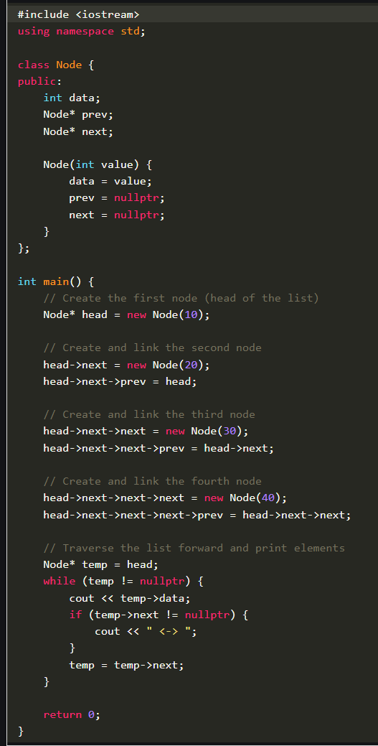

Slide 53
Deleting a Node
Delete a node Cur (not at front or rear)
(Cur->prev)->next = Cur->next;
(Cur->next)->prev = Cur->prev;
delete Cur;
10
20
40
55
70
Head
Cur

Slide 54
void deleteNode(NodePtr& head, int item) {
NodePtr cur;
cur = searchNode(head, item);
if (head==NULL) { …
}
else if (cur->prev == NULL) { …
}
else if (cur->next==NULL) { …
}
else {
(cur->prev)->next = cur->next;
(cur->next)->prev = cur->prev;
delete cur;
}
}
Empty case
At-the-beginning case
At-the-end case
General case
A systematic way is to start from all these cases, then try to simply the codes, …

Slide 55
Inserting a Node
Insert a node New before Cur (not at front or rear)
New->next = Cur;
New->prev = Cur->prev;
Cur->prev = New;
(New->prev)->next = New;
10
20
55
70
40
Head
Cur
New

Slide 56
void insertNode(NodePtr& head, int item) {
NodePtr cur;
cur = searchNode(head, item);
if (head==NULL) { …
}
else if (cur->prev == NULL) { …
}
else if (cur->next==NULL) { …
}
else {
blablabla … }
}
Many special cases to consider.

Slide 57
Many different linked lists …
singly linked lists
  Without ‘dummy’
  With dummy
  circular
doubly linked lists
  Without ‘dummy’
  With dummy
Using ‘dummy’ is a matter of personal preference!
+ simplify codes (not that much ☺
- Less logically sounds

Slide 58
singly linked list
Head
10
20
40
55
70
20
(singly) circular linked list
10
20
40
55
70
Rear
(regular) doubly linked list
10
20
40
55
70
Head
doubly linked list with dummy
Dummy
10
20
40
55
70
Head

Slide 59
Doubly Linked Lists with Dummy Head Node
To simplify insertion and deletion by avoiding special cases of deletion and insertion at front and rear, a dummy head node is added at the head of the list
The last node also points to the dummy head node as its successor

Slide 60
Idea of ‘dummy’ object
‘dummy object’ is also called a ‘sentinel’, it allows the simplification of special cases, but confuses the emptyness NULL!
Instead of pointing to NULL, point to the ‘dummy’!!!
Skip over the dummy for the real list
Dummy Head Node
10
20
40
55
70
Head

Slide 61
Empty list:
Dummy Head Node
Head
Head->next = head; compared with head=NULL;

Slide 62
operations
Doubly linked with dummy
Singly linked
void createHead(NodePtr& head){
head = new Node;
head->next = head;
head->prev = head;
}
NodePtr head;
createHead(head);
NodePtr cur=head;
cur=cur->next;
cur=head; // dummy head
NodePtr head=NULL;
NodePtr cur=head;
cur=head;
cur=NULL; // or head=NULL;
creation
reference
Start from
Empty test

Slide 63
Print the whole list:
void print(NodePtr head){
NodePtr cur=head->next;
while(cur != head){
cout << cur->data << " ";
cur = cur->next;
}
}

Slide 64
Searching a node
(returning NULL if not found the element):
NodePtr searchNode(NodePtr head, int item){
NodePtr cur = head->next;
while ((cur != head) && (item != cur->data)) cur=cur->next;
if (cur == head) cur = NULL; // we didn’t find
return cur;
}
End of the list, empty

Slide 65
Deleting a Node
Delete a node Cur at front
(Cur->prev)->next = Cur->next;
(Cur->next)->prev = Cur->prev;
delete Cur;
Dummy Head Node
10
20
40
55
70
Head
Cur

Slide 66
Delete a node Cur in the middle
(Cur->prev)->next = Cur->next;
(Cur->next)->prev = Cur->prev;
delete Cur; // same as delete front!
Dummy Head Node
10
20
40
55
70
Cur
Head

Slide 67
Delete a node Cur at rear
(Cur->prev)->next = Cur->next;
(Cur->next)->prev = Cur->prev;
delete Cur; // same as delete front and middle!
Dummy Head Node
10
20
40
55
70
Head
Cur

Slide 68
void deleteNode(NodePtr head, int item){
NodePtr cur;
cur = searchNode(head, item);
if(cur != NULL){
cur->prev->next = cur->next;
cur->next->prev = cur->prev;
delete cur;
}
}
If we found the element, it does not mean any emptyness!

Slide 69
Inserting a Node
Insert a Node New after dummy node and before Cur
New->next = Cur;
New->prev = Cur->prev;
Cur->prev = New;
(New->prev)->next = New;
Dummy Head Node
20
10
Head
New
Cur

Slide 70
Insert a Node New at Rear (with Cur pointing to dummy head)
New->next = Cur;
New->prev = Cur->prev;
Cur->prev = New;
(New->prev)->next = New;
Dummy Head Node
10
20
40
55
70
Cur
Head
New

Slide 71
Insert a Node New in the middle and before Cur
New->next = Cur;
New->prev = Cur->prev;
Cur->prev = New;
(New->prev)->next = New;
Dummy Head Node
10
20
55
40
New
Cur
Head

Slide 72
Insert a Node New to Empty List (with Cur pointing to dummy head node)
New->next = Cur;
New->prev = Cur->prev;
Cur->prev = New;
(New->prev)->next = New;
Dummy Head Node
20
Head
Cur
New

Slide 73
void insertNode(NodePtr head, int item){
NodePtr newp, cur;
newp = new Node;
newp->data = item;
cur = head->next;
while ((cur != head)&&(!(item<=cur->data)))
cur = cur->next;
newp->next = cur;
newp->prev = cur->prev;
cur->prev = newp;
(newp->prev)->next = newp;
}
creation
location
insertion
It is similar to, but different from SearchNode!
(it returns NULL if no element)

Slide 74
void main(){
NodePtr Head, temp;
createHead(Head);
insertNode(Head, 3);
insertNode(Head, 5);
insertNode(Head, 2);
print(Head);
insertNode(Head, 7);
insertNode(Head, 1);
insertNode(Head, 8);
print(Head);
deleteNode(Head, 7);
deleteNode(Head, 0);
print(Head);
temp = searchNode(Head, 5);
if(temp !=NULL)
cout<<" Data is contained in the list"<<endl;
else
cout<<" Data is NOT contained in the list"<<endl;
}
Result is
2 3 5
1 2 3 5 7 8
1 2 3 5 8
Data is contained in the list

